Slide 1

What’s the Big Deal?
Global Trends and Movements Shaping Higher Ed
Brandon Butler
Director of Information Policy
UVA Library
Open Access Week 2019
This work is licensed with Creative Commons Zero (CC0) license.
Trademarks are the property of their respective owners.

Slide 2
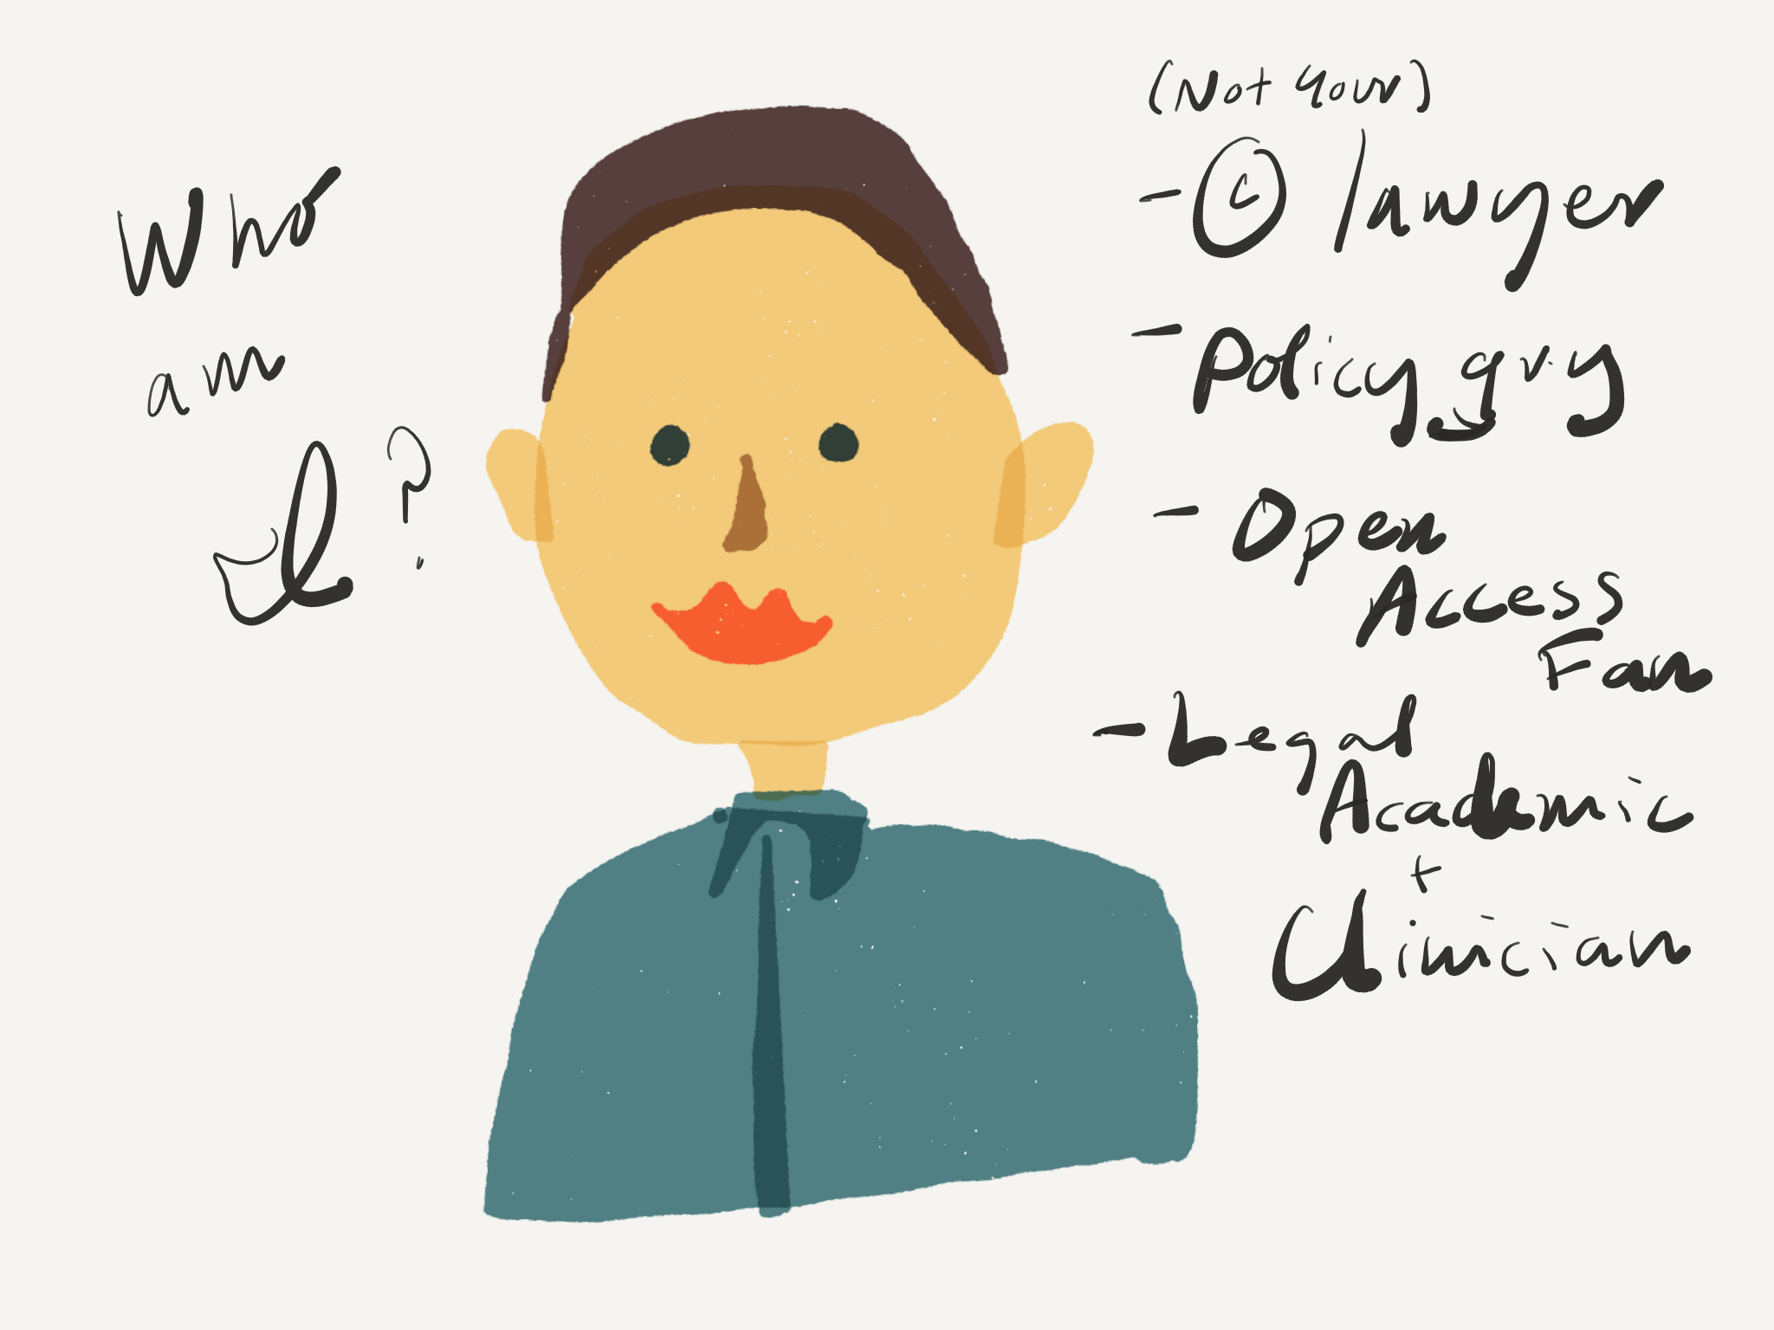

Slide 3
Road Map
What are Big Deals
Global Consensus for Change
Pressures Fueling the Change
Rising Price
Declining Value
Diverging Values
Life After Big Deals

Slide 4
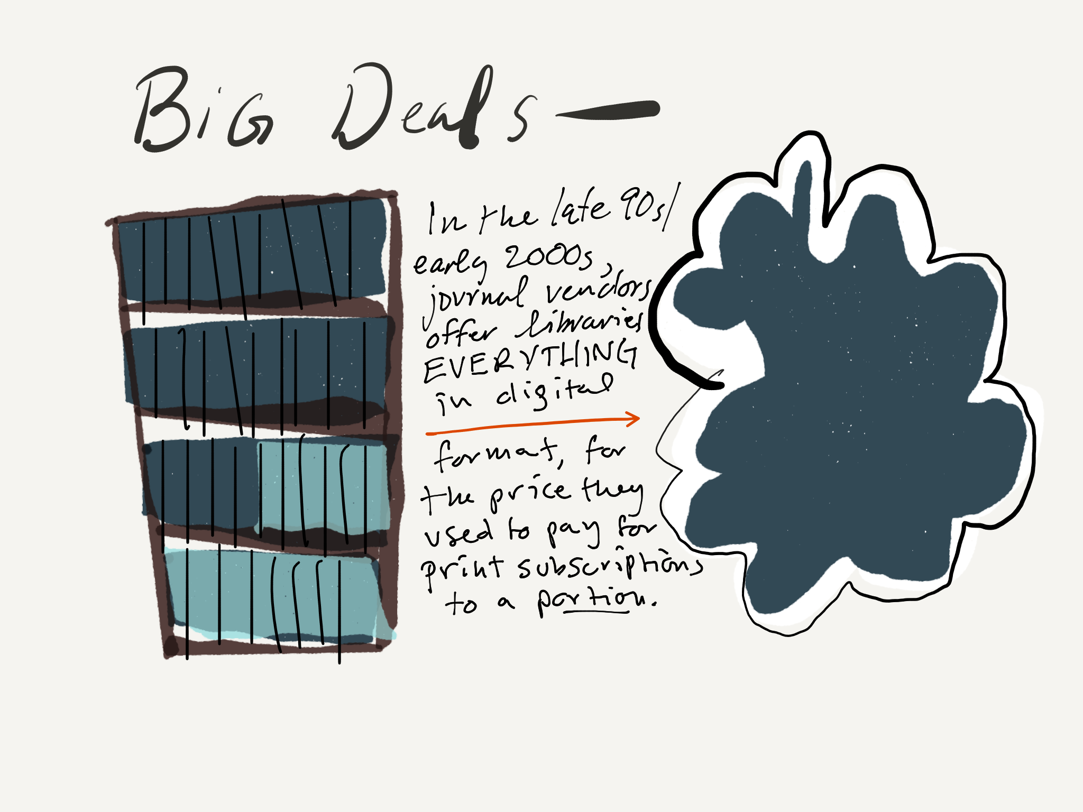

Slide 5

Global consensus
for change

Slide 6
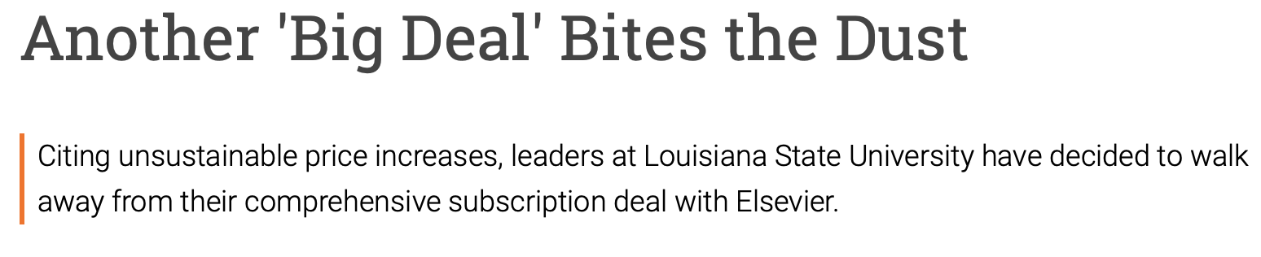
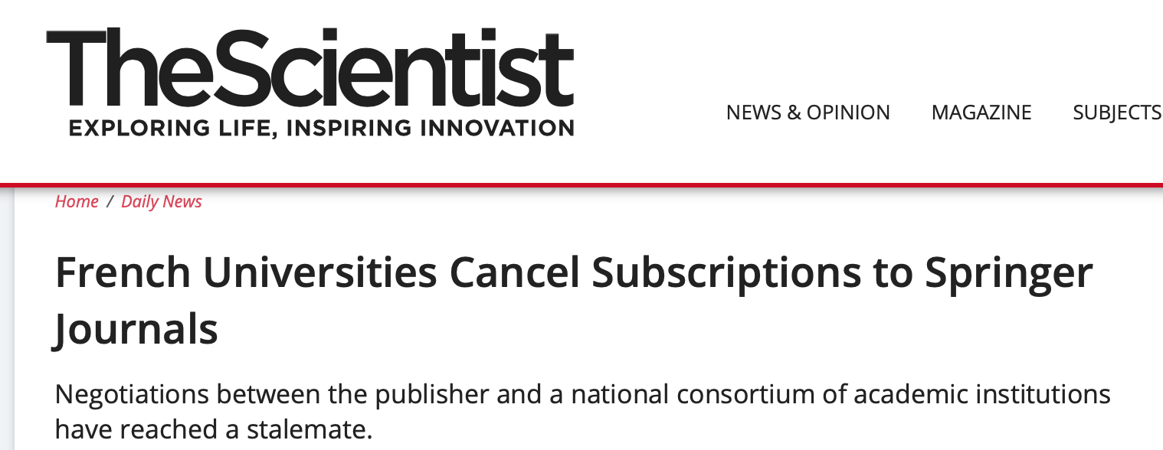
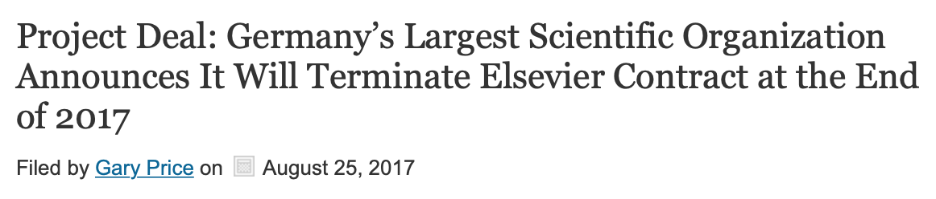
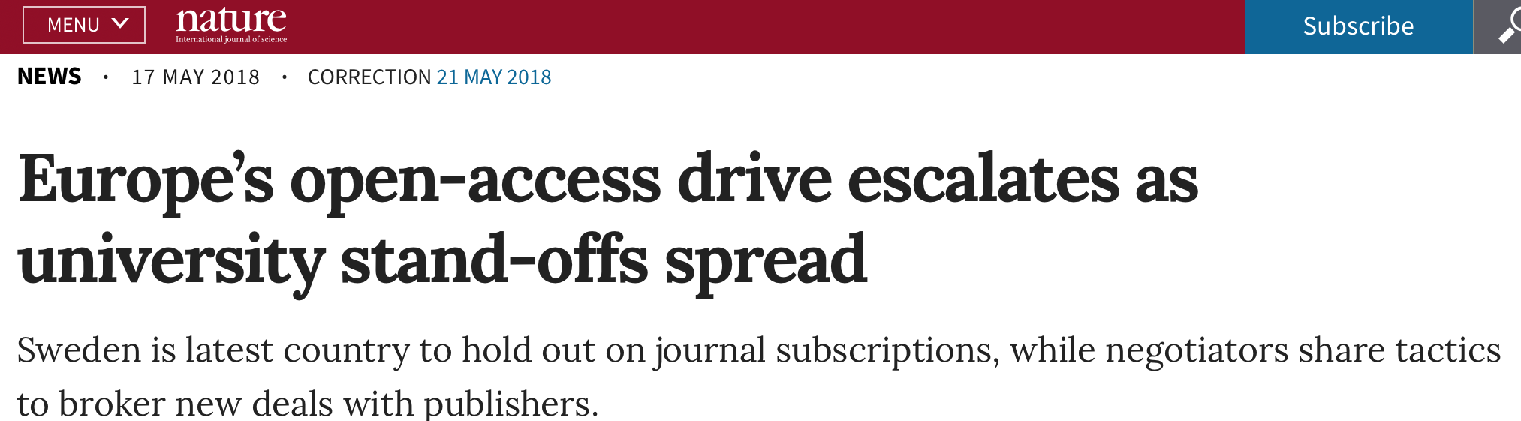
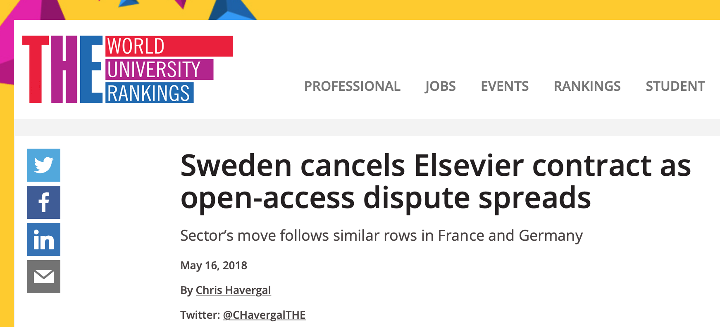


Slide 7
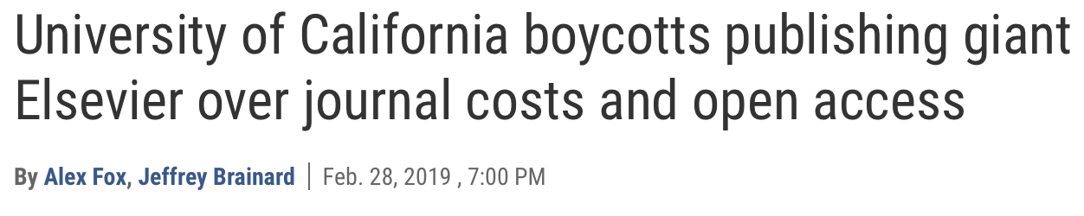
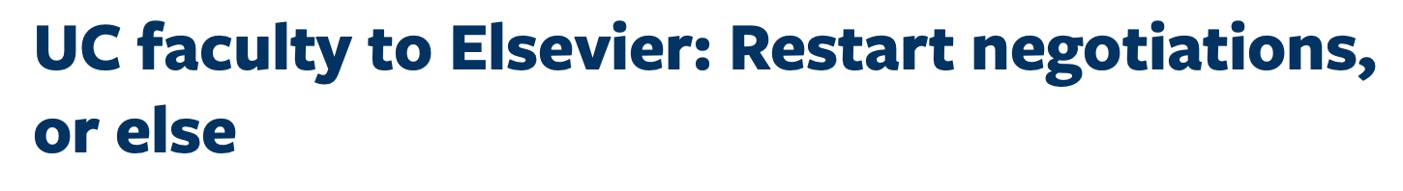
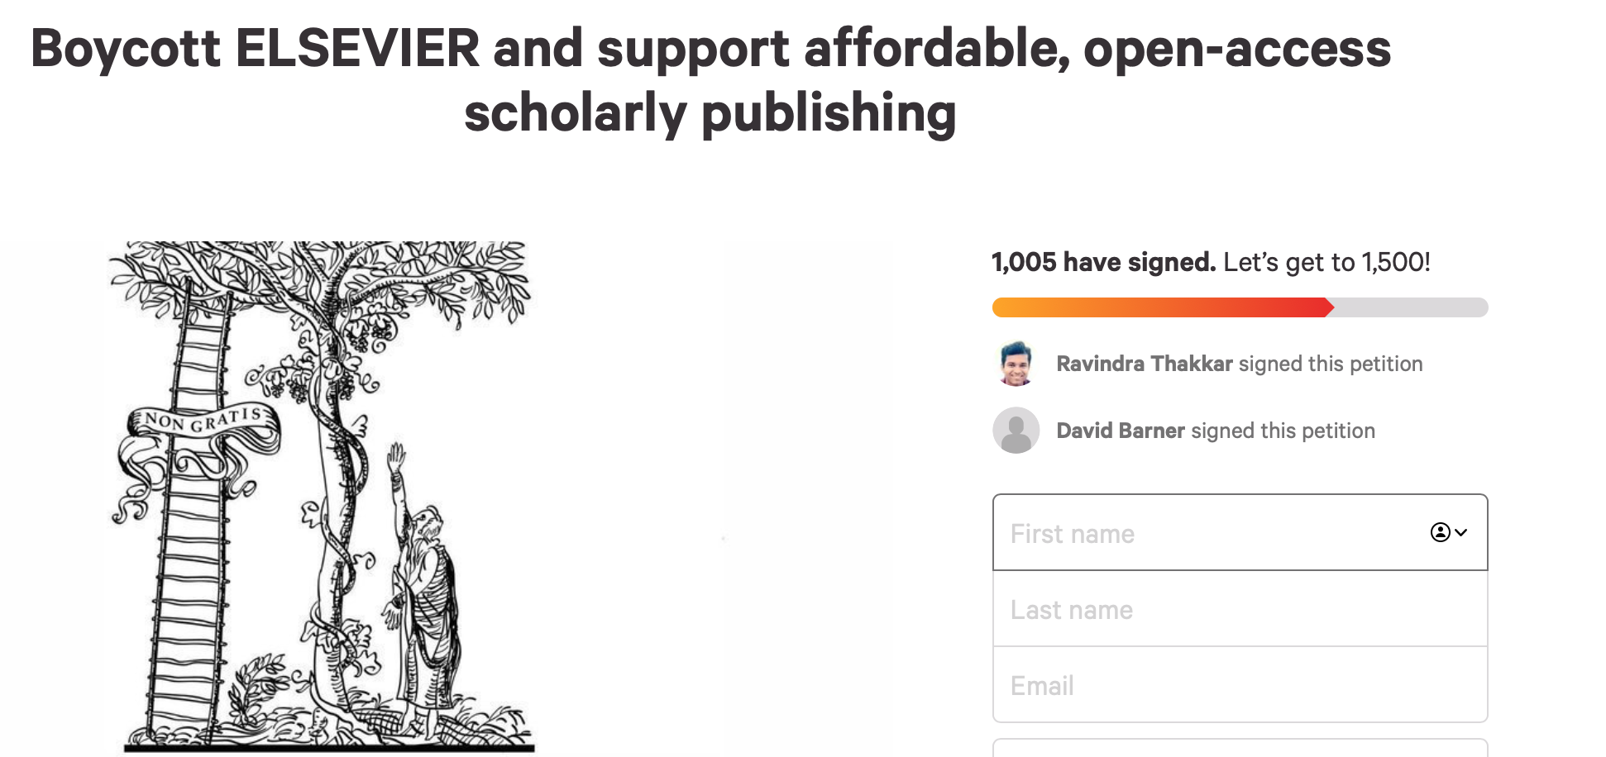

Slide 8
Trend 1: Purely Price-induced Breakups
Long-running, global phenomenon fueled by serials price inflation, exacerbated by macro-economic factors (2008 recession, state funding crises, currency fluctuation)
These institutions replace Big Deals with subscriptions to a sub-set of titles—80-20 rule typically applies (top 20% of titles account for 80% of usage)
Examples: Harvard, Florida State University, CalTech, WVU, U. de Montreal, LSU, IA State, UKansas

Slide 9
Trend 2: Price+OA Walkaways
Much more recent phenomenon, spurred by EU policy aspiration of “flipping” all academic content to open access by 2020
Seeing APC model as unsustainable, inst’ns seek to bundle subscription and open publishing charges into one package - “read-and-publish,” “offsetting,” or “OA Big Deal”
Elsevier has not accepted these terms, leading to complete cancellation:
Projekt Deal (Germany), Sweden, Norway
France, later struck a deal with prices going steadily down
The University of California system walked away from Elsevier in February, lost access in July

Slide 10
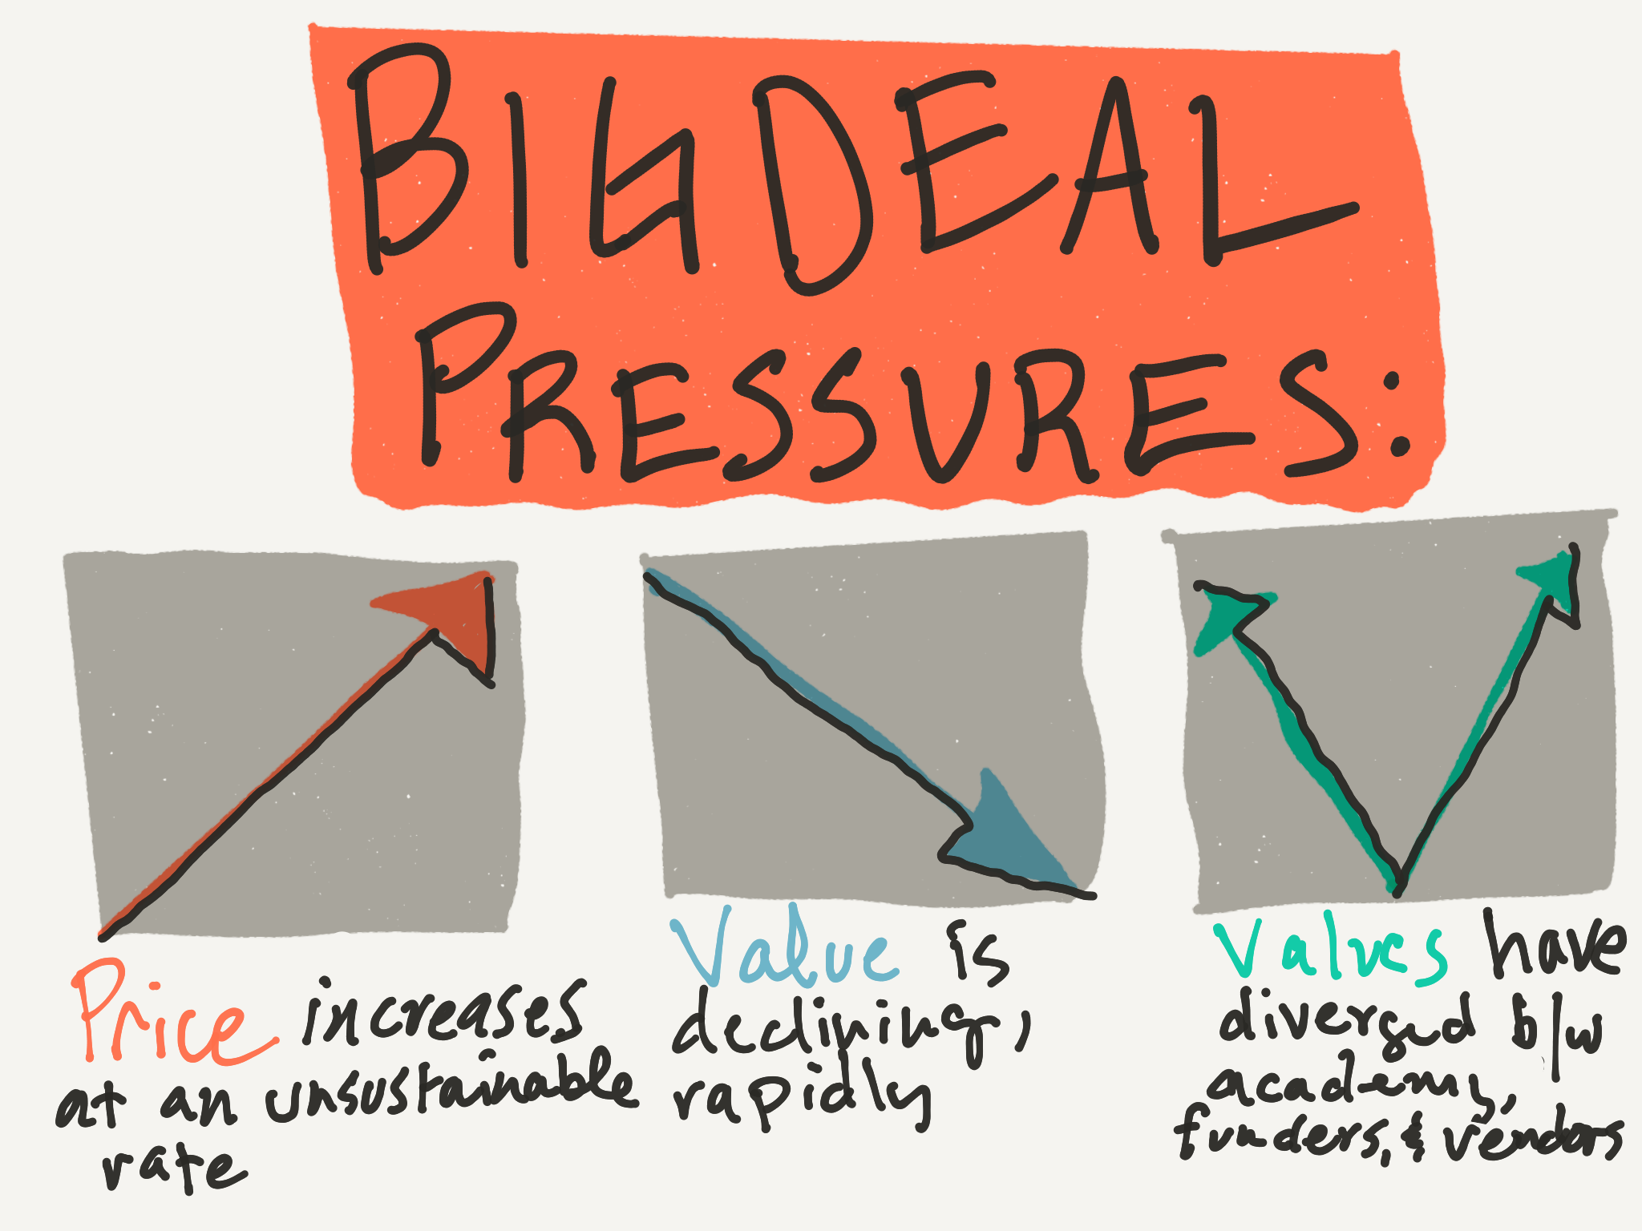

Slide 11
Unsustainable Price Inflation
Long-running “serials crisis” in libraries
Fueled by profit-taking among the biggest commercial vendors
Crowding out everything else in our budget
Concentrating power in a few big vendors
Facilitated by sharp practices
Completely divorced from cost/value/use of publisher’s contribution

Slide 12
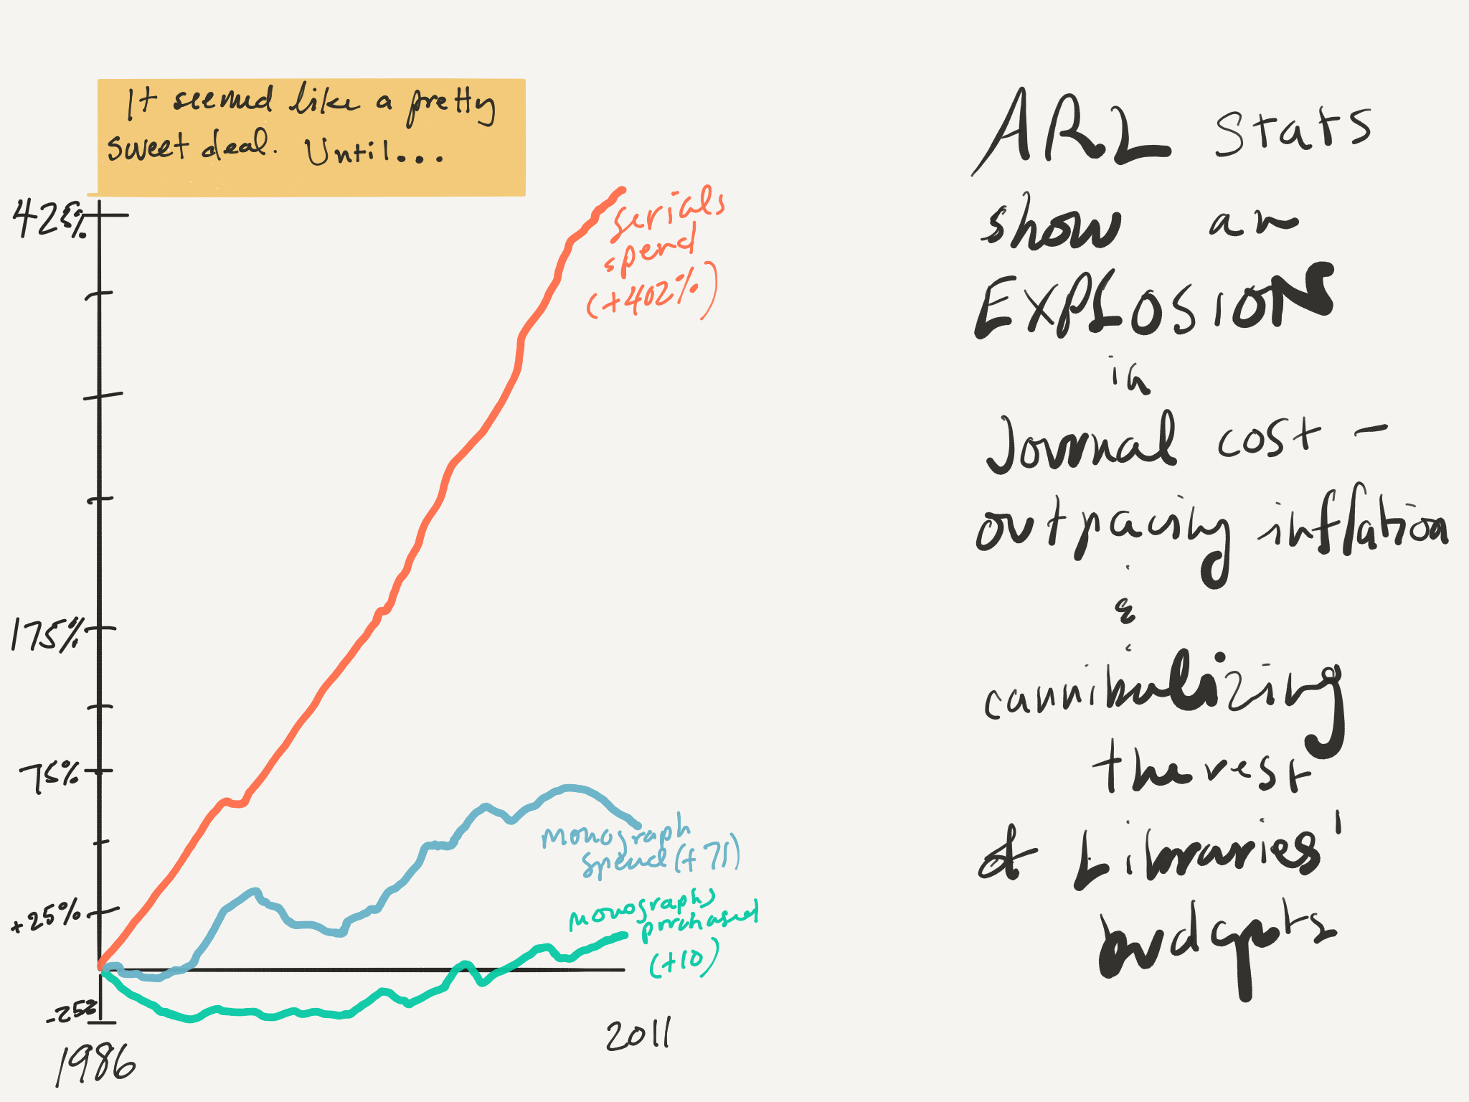

Slide 13
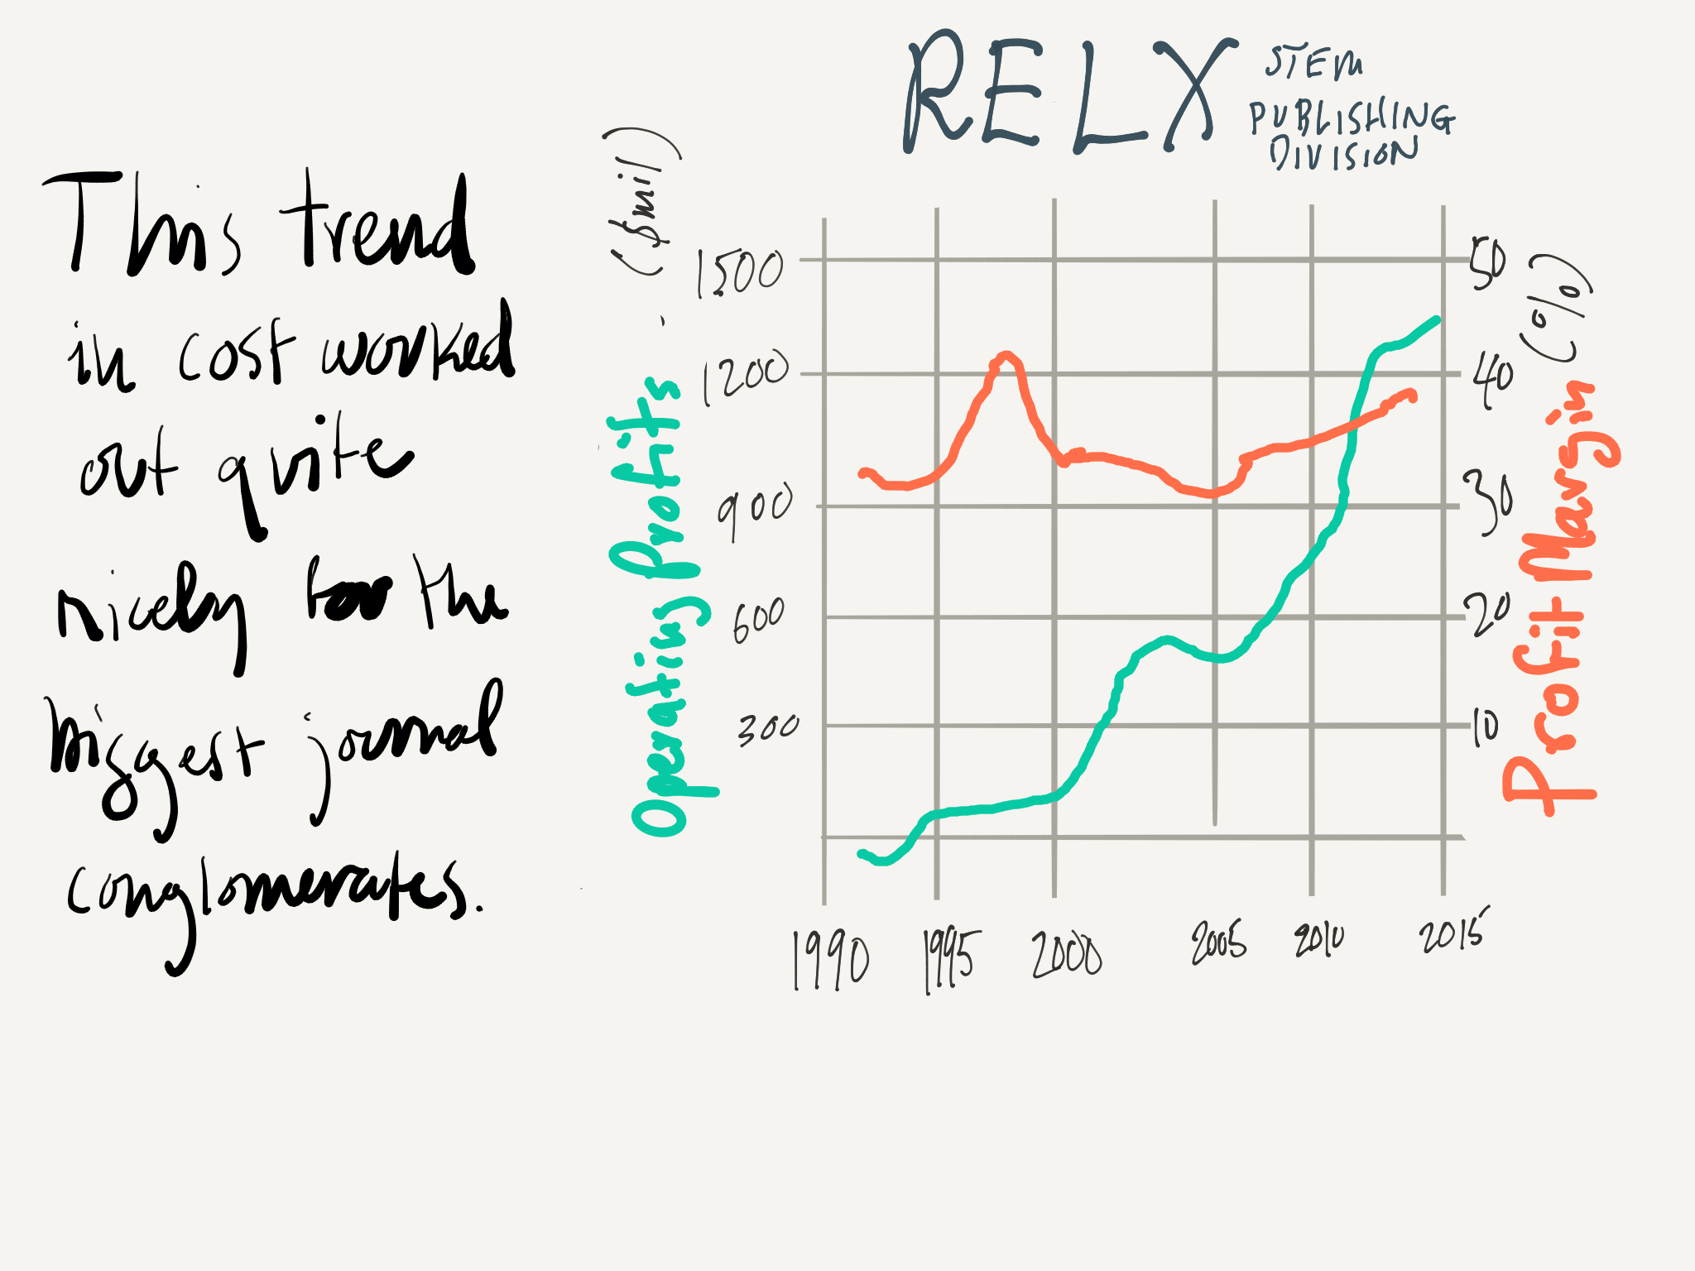

Slide 14
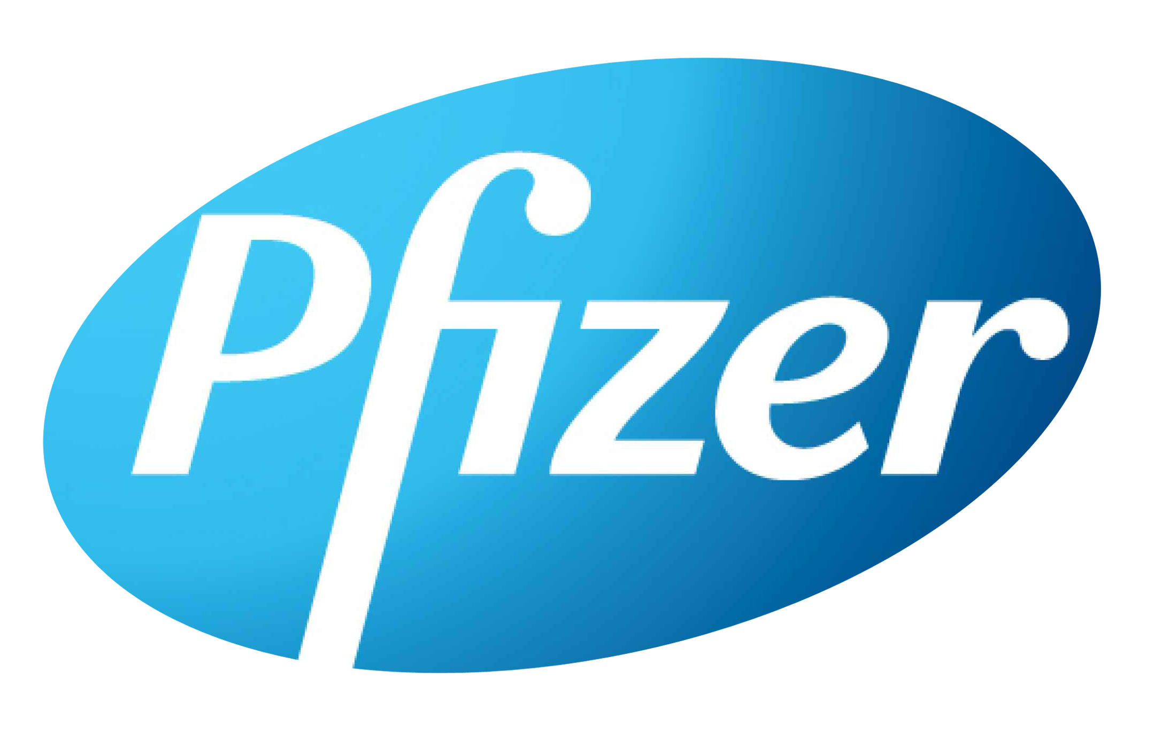
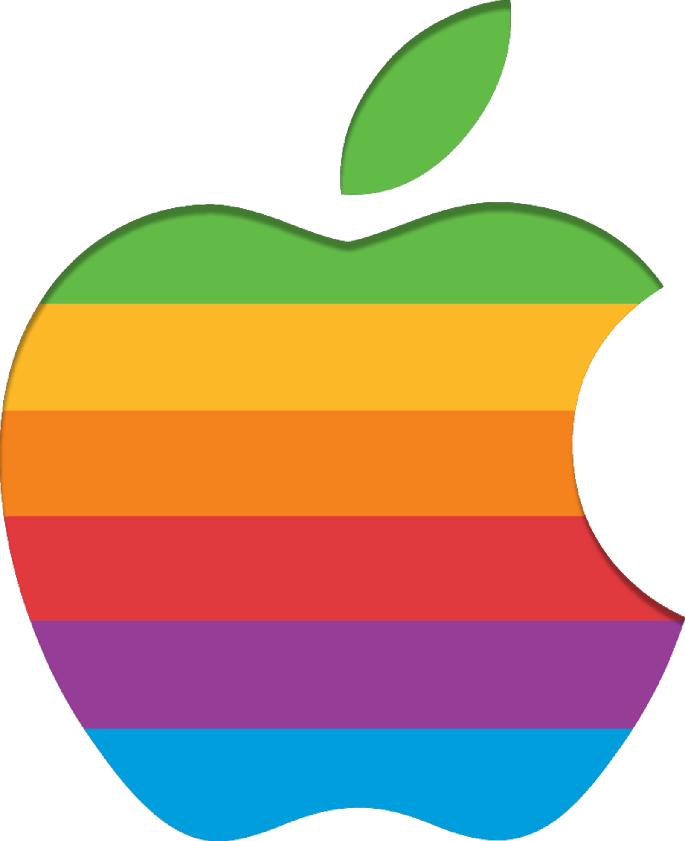


Banks, Drugs, Cars, iPads, and… Journals
Pharmaceuticals (Pfizer): 42%
RELX (Elsevier): 39%
Apple: 37%
T&F: 36%
Springer: 35%
Banking (Industrial & Commercial Bank of China): 29%
Wiley: 28%
Automotive (Hyundai): 10%

Slide 15
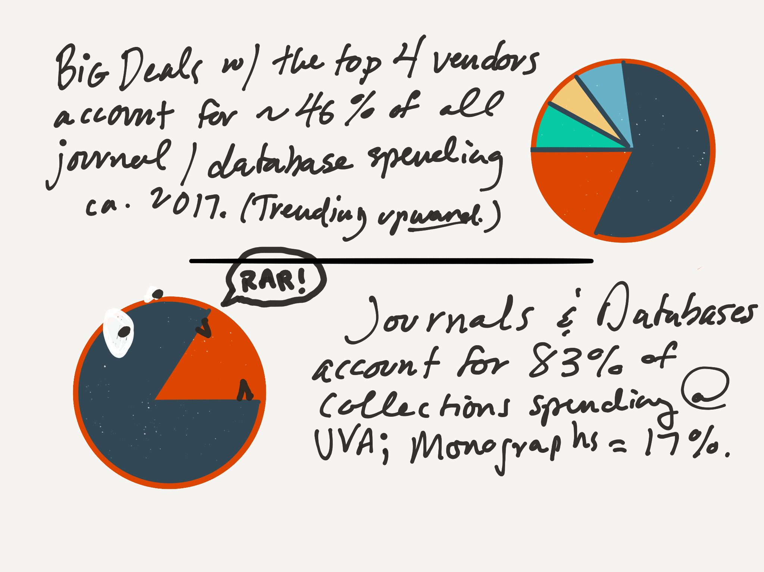

Slide 16
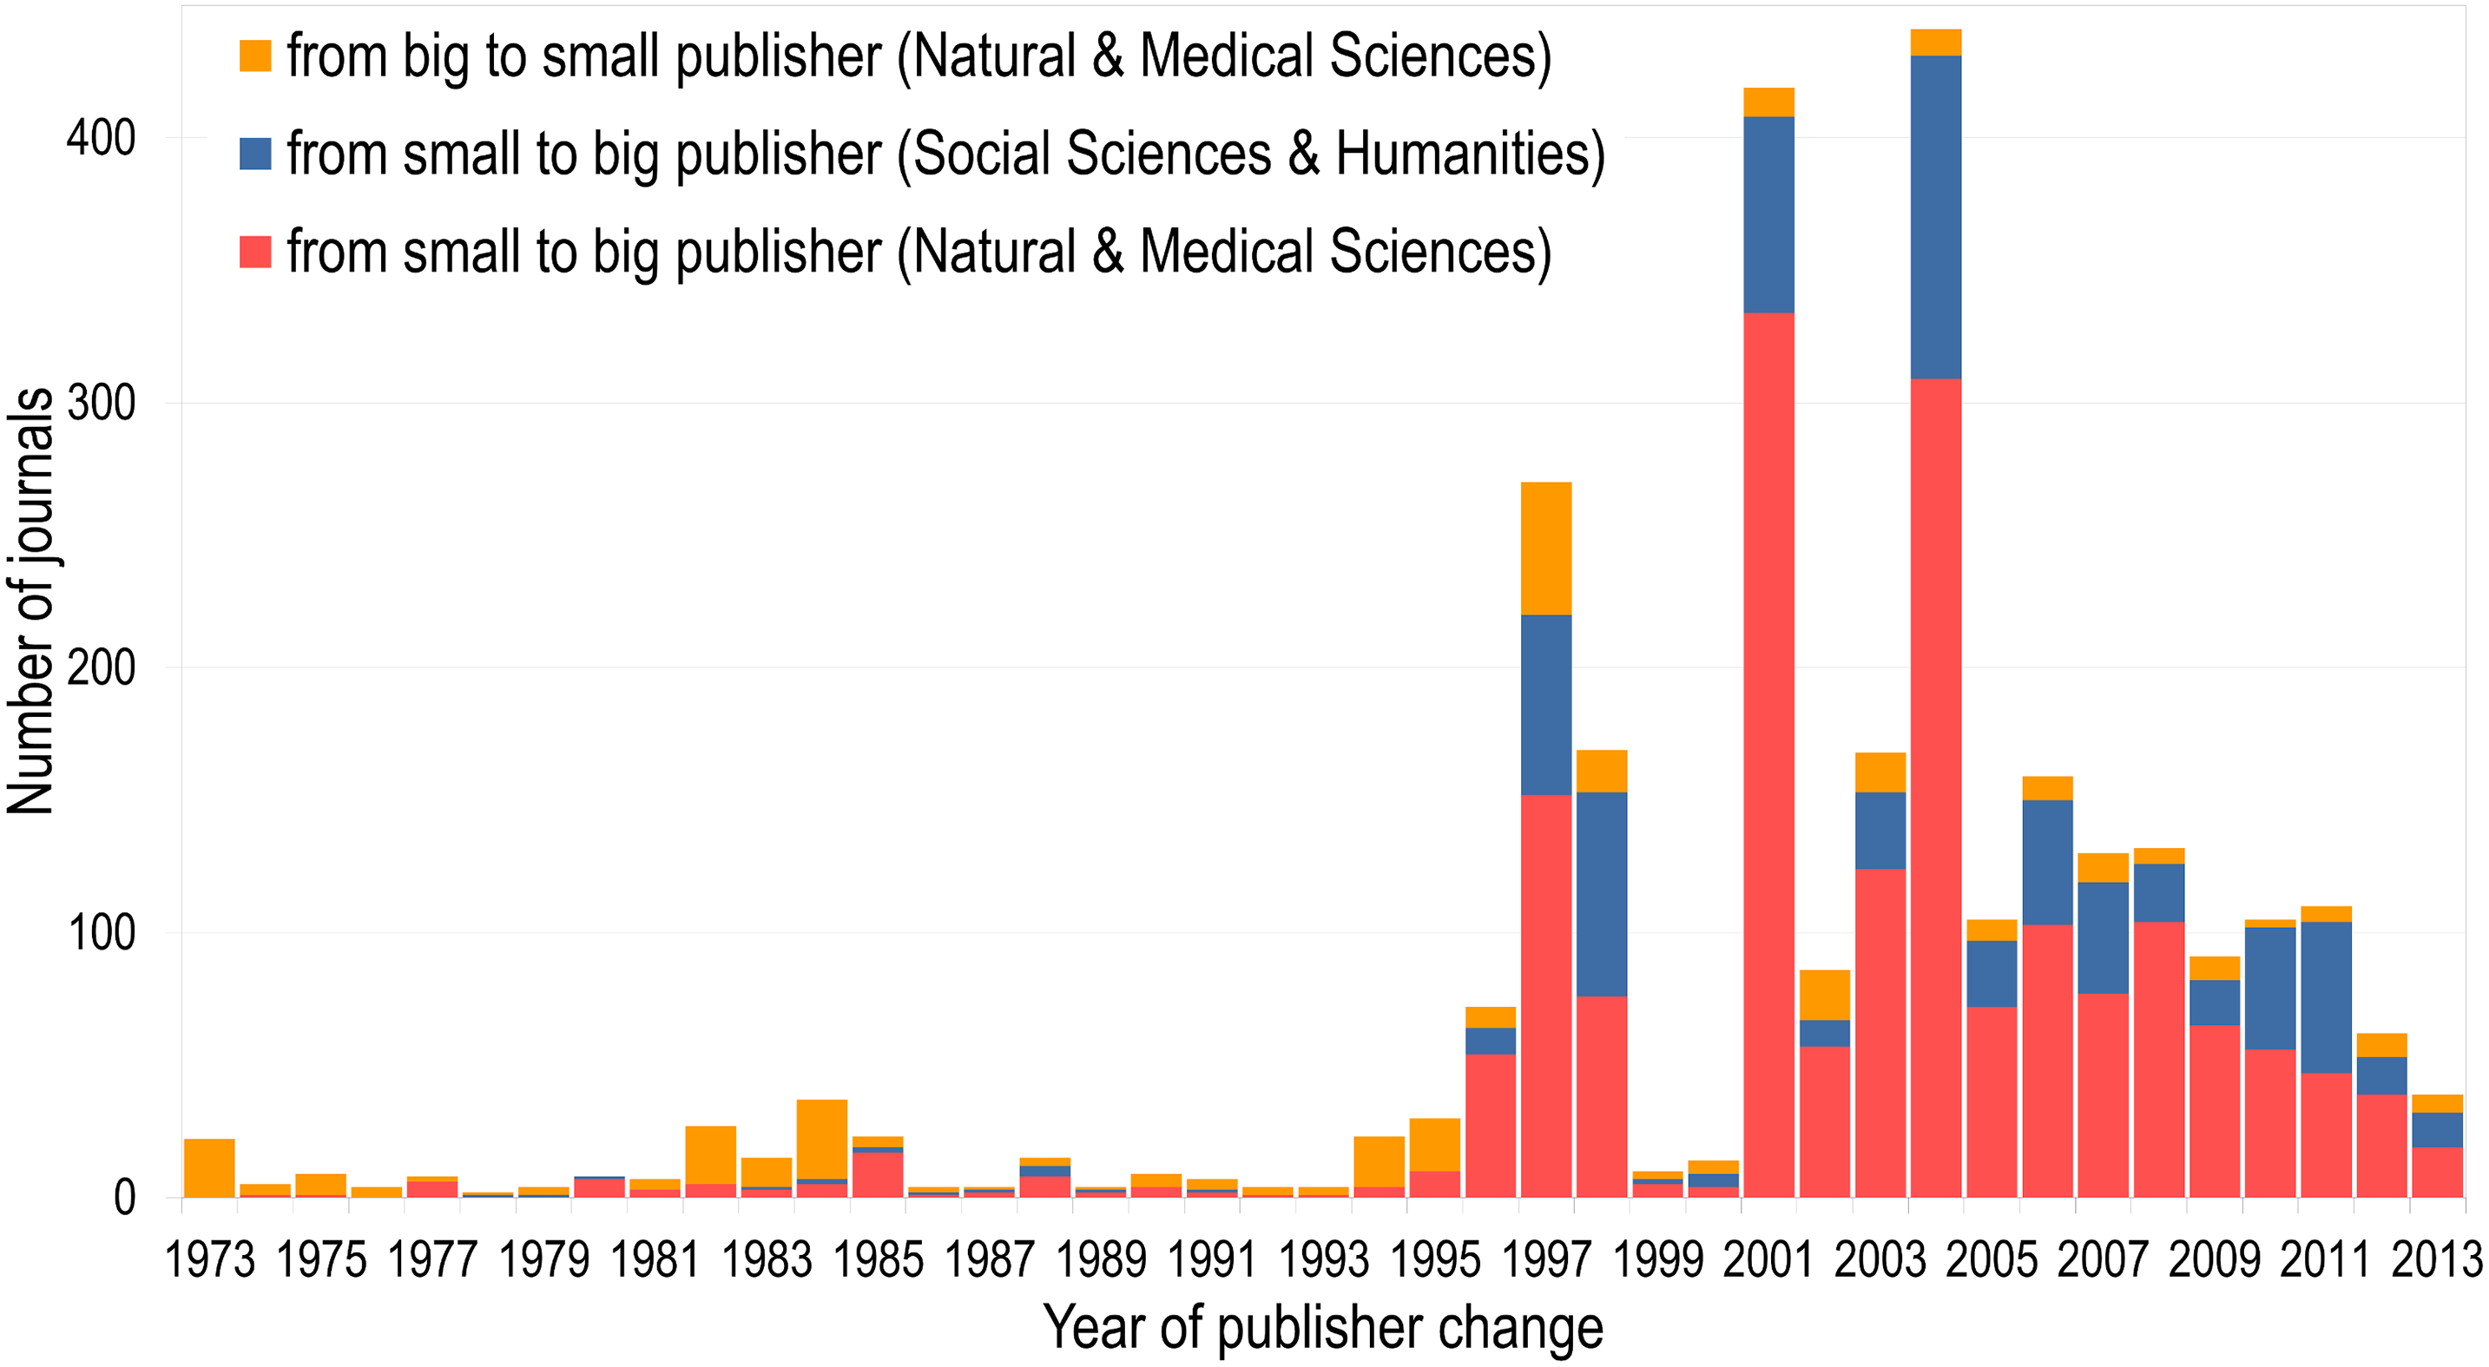
from Larivière V, Haustein S, Mongeon P (2015) The Oligopoly of Academic Publishers in the Digital Era. PLOS ONE 10(6): e0127502. https://doi.org/10.1371/journal.pone.0127502

Slide 17
Sharp Bargaining Practices
Punitive a la carte prices
No discounts on smaller packages
Punitive fees for exiting Big Deals
Resistance to consortial bargaining
Negotiations deferred to the last minute

Slide 18


Slide 19
Big Deal Value in Decline
Adjusting Cost Per Use
Other problems with CPU
Alternative access on the rise

Slide 20
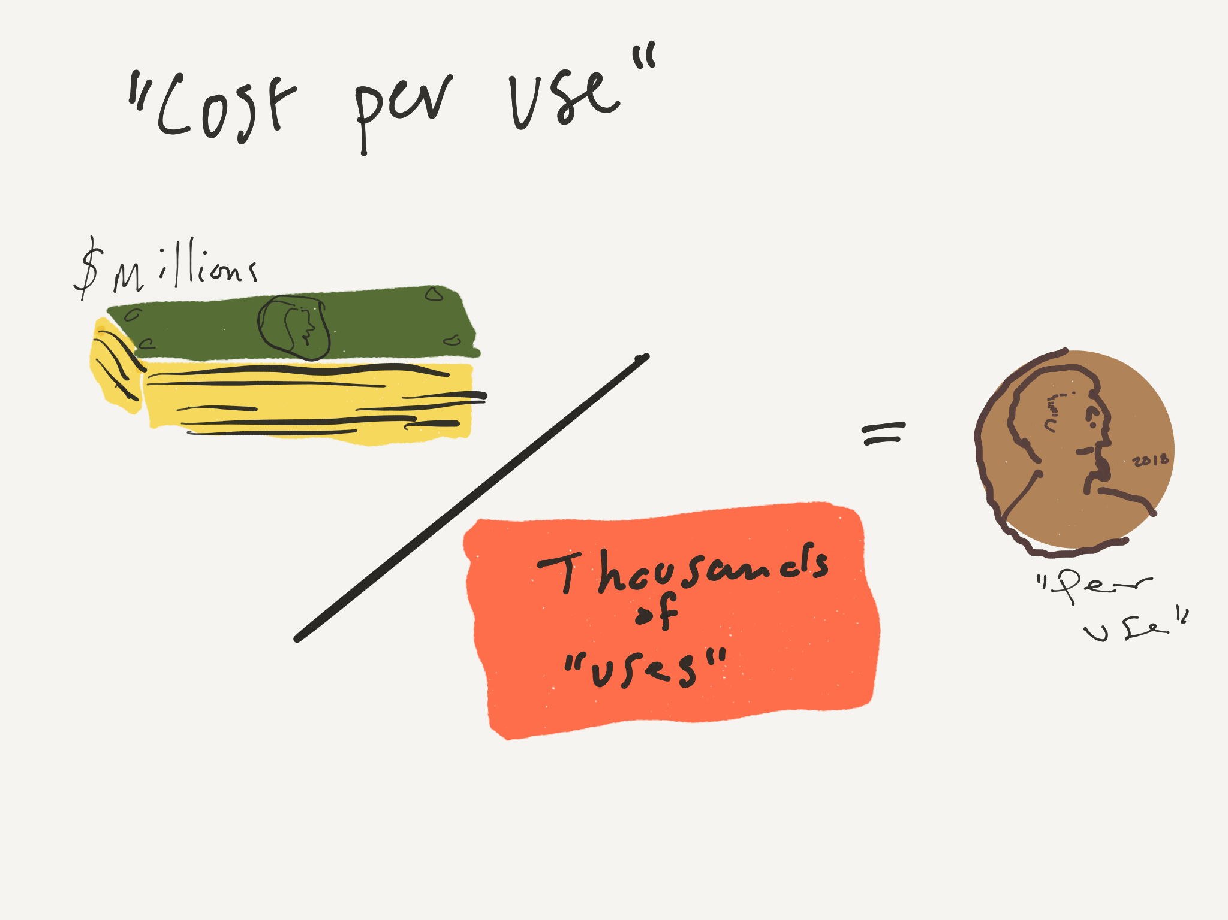

Slide 21
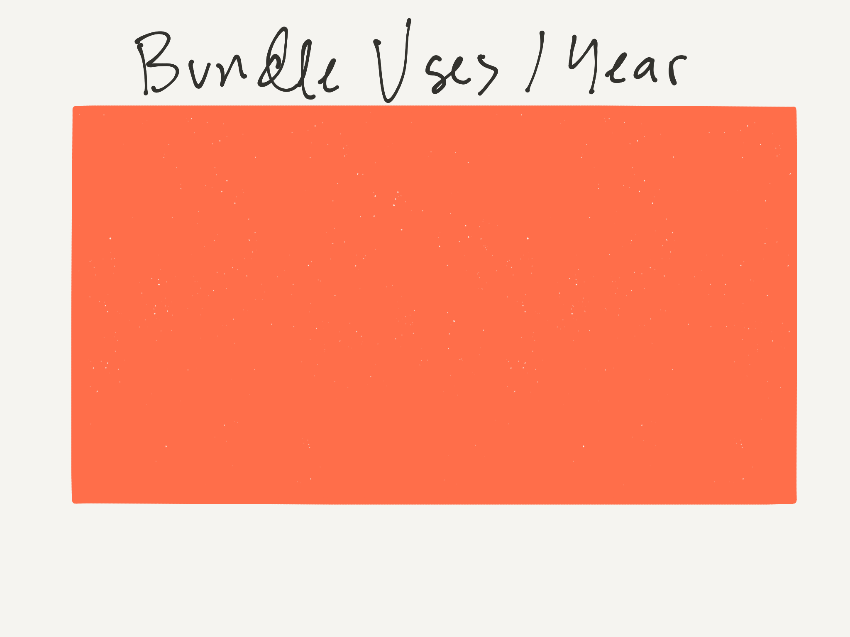

Slide 22
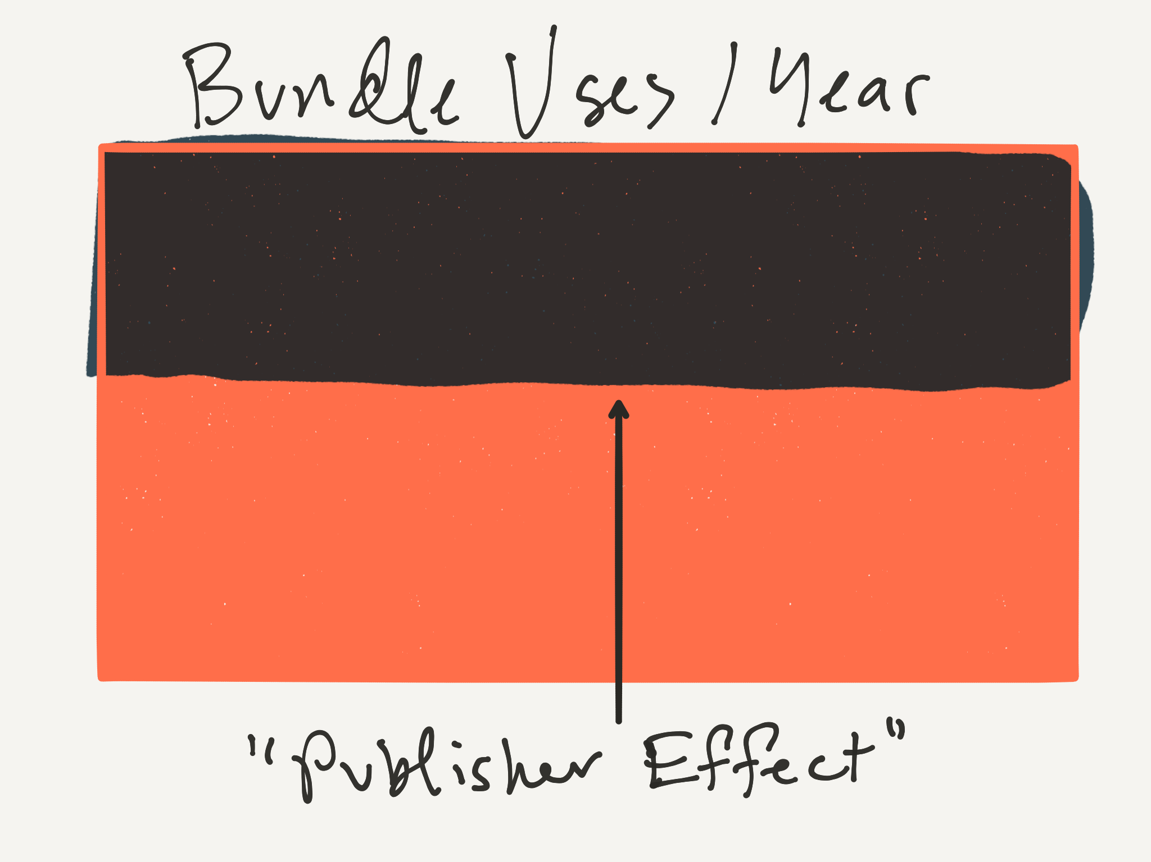

Slide 23
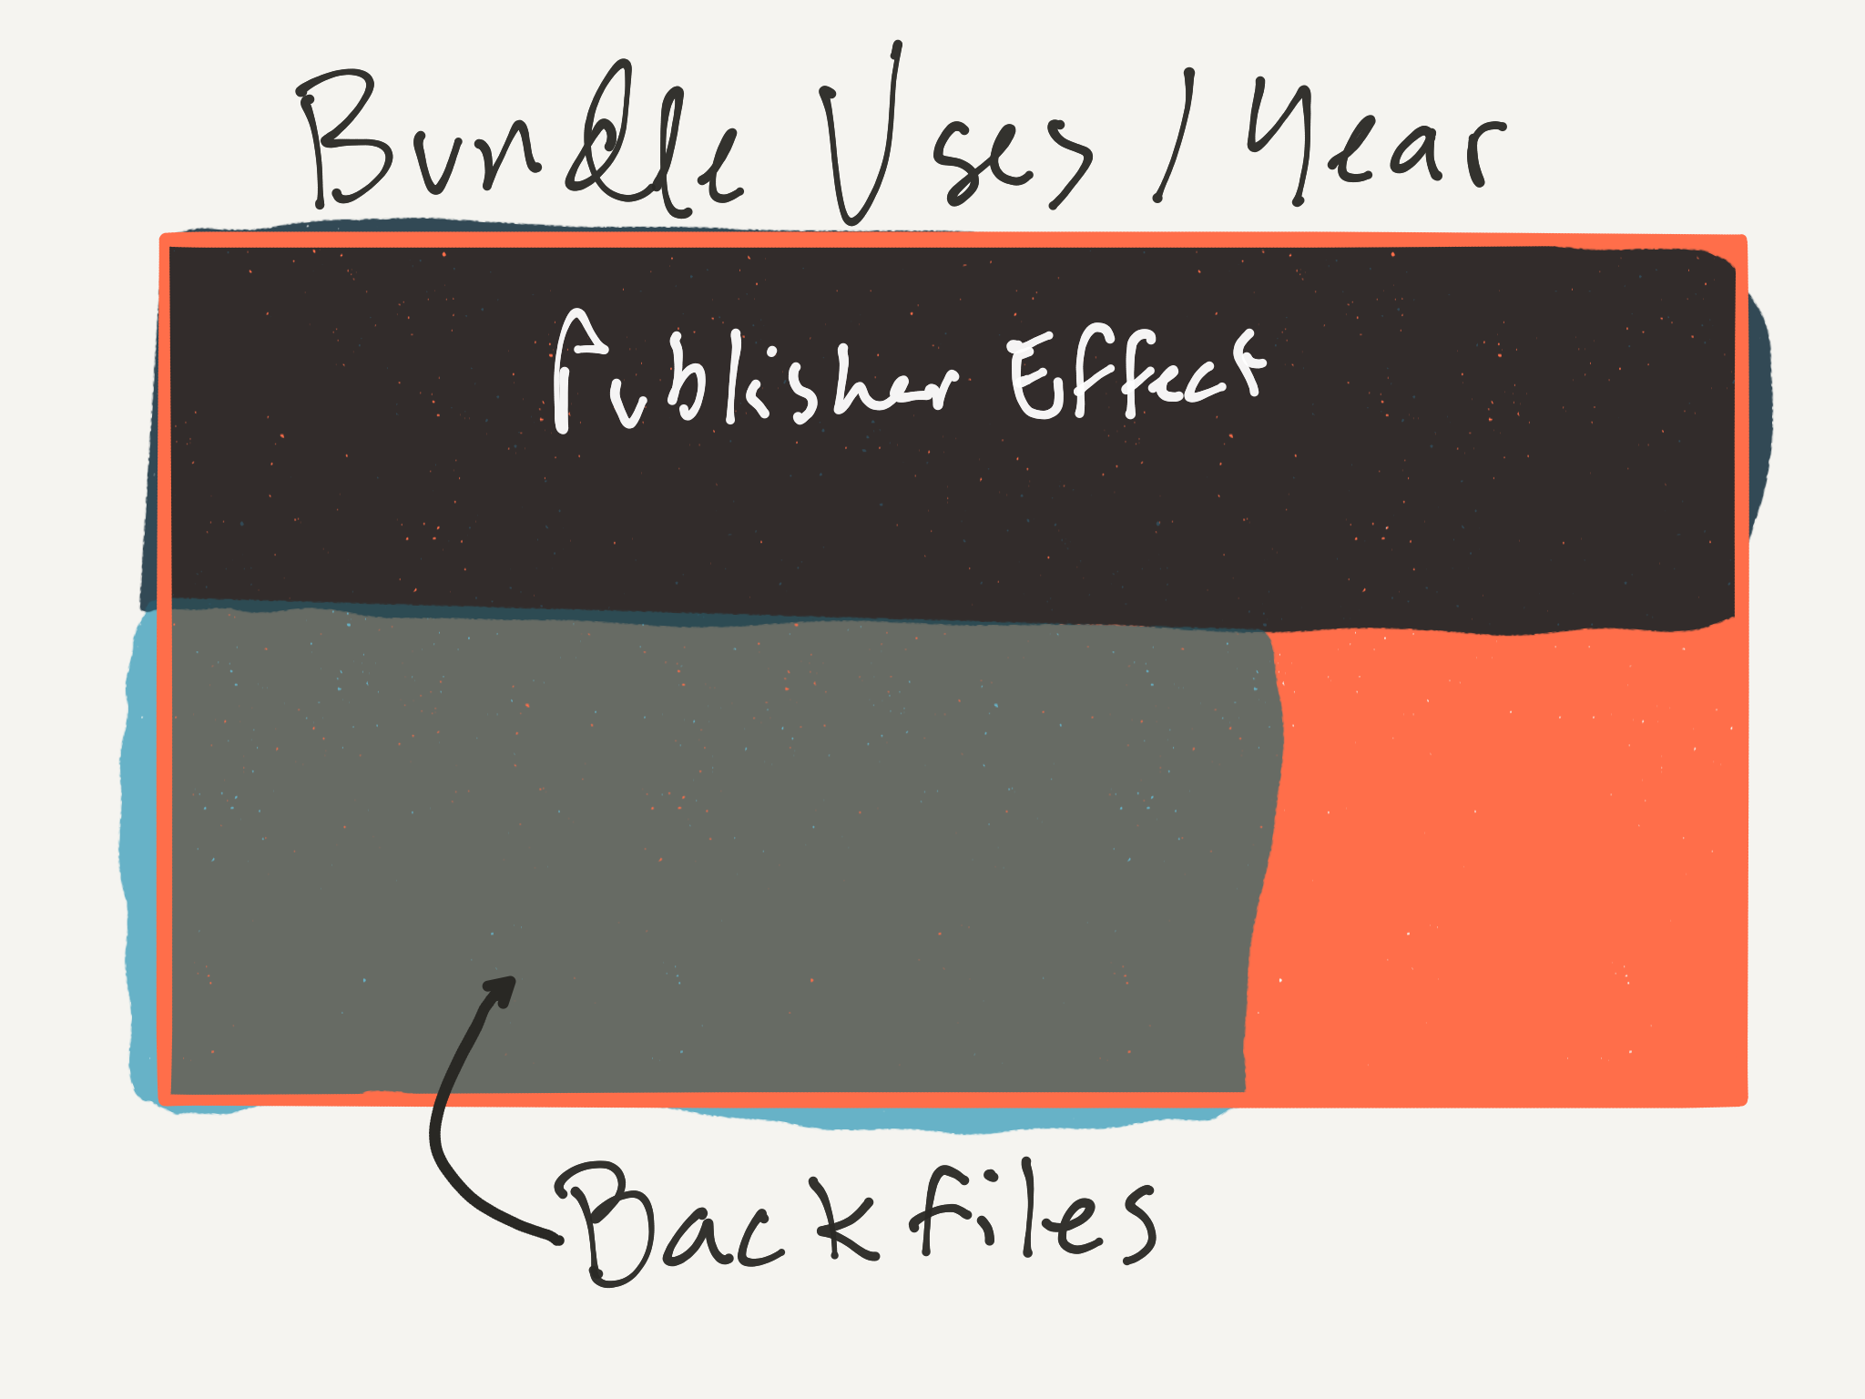

Slide 24
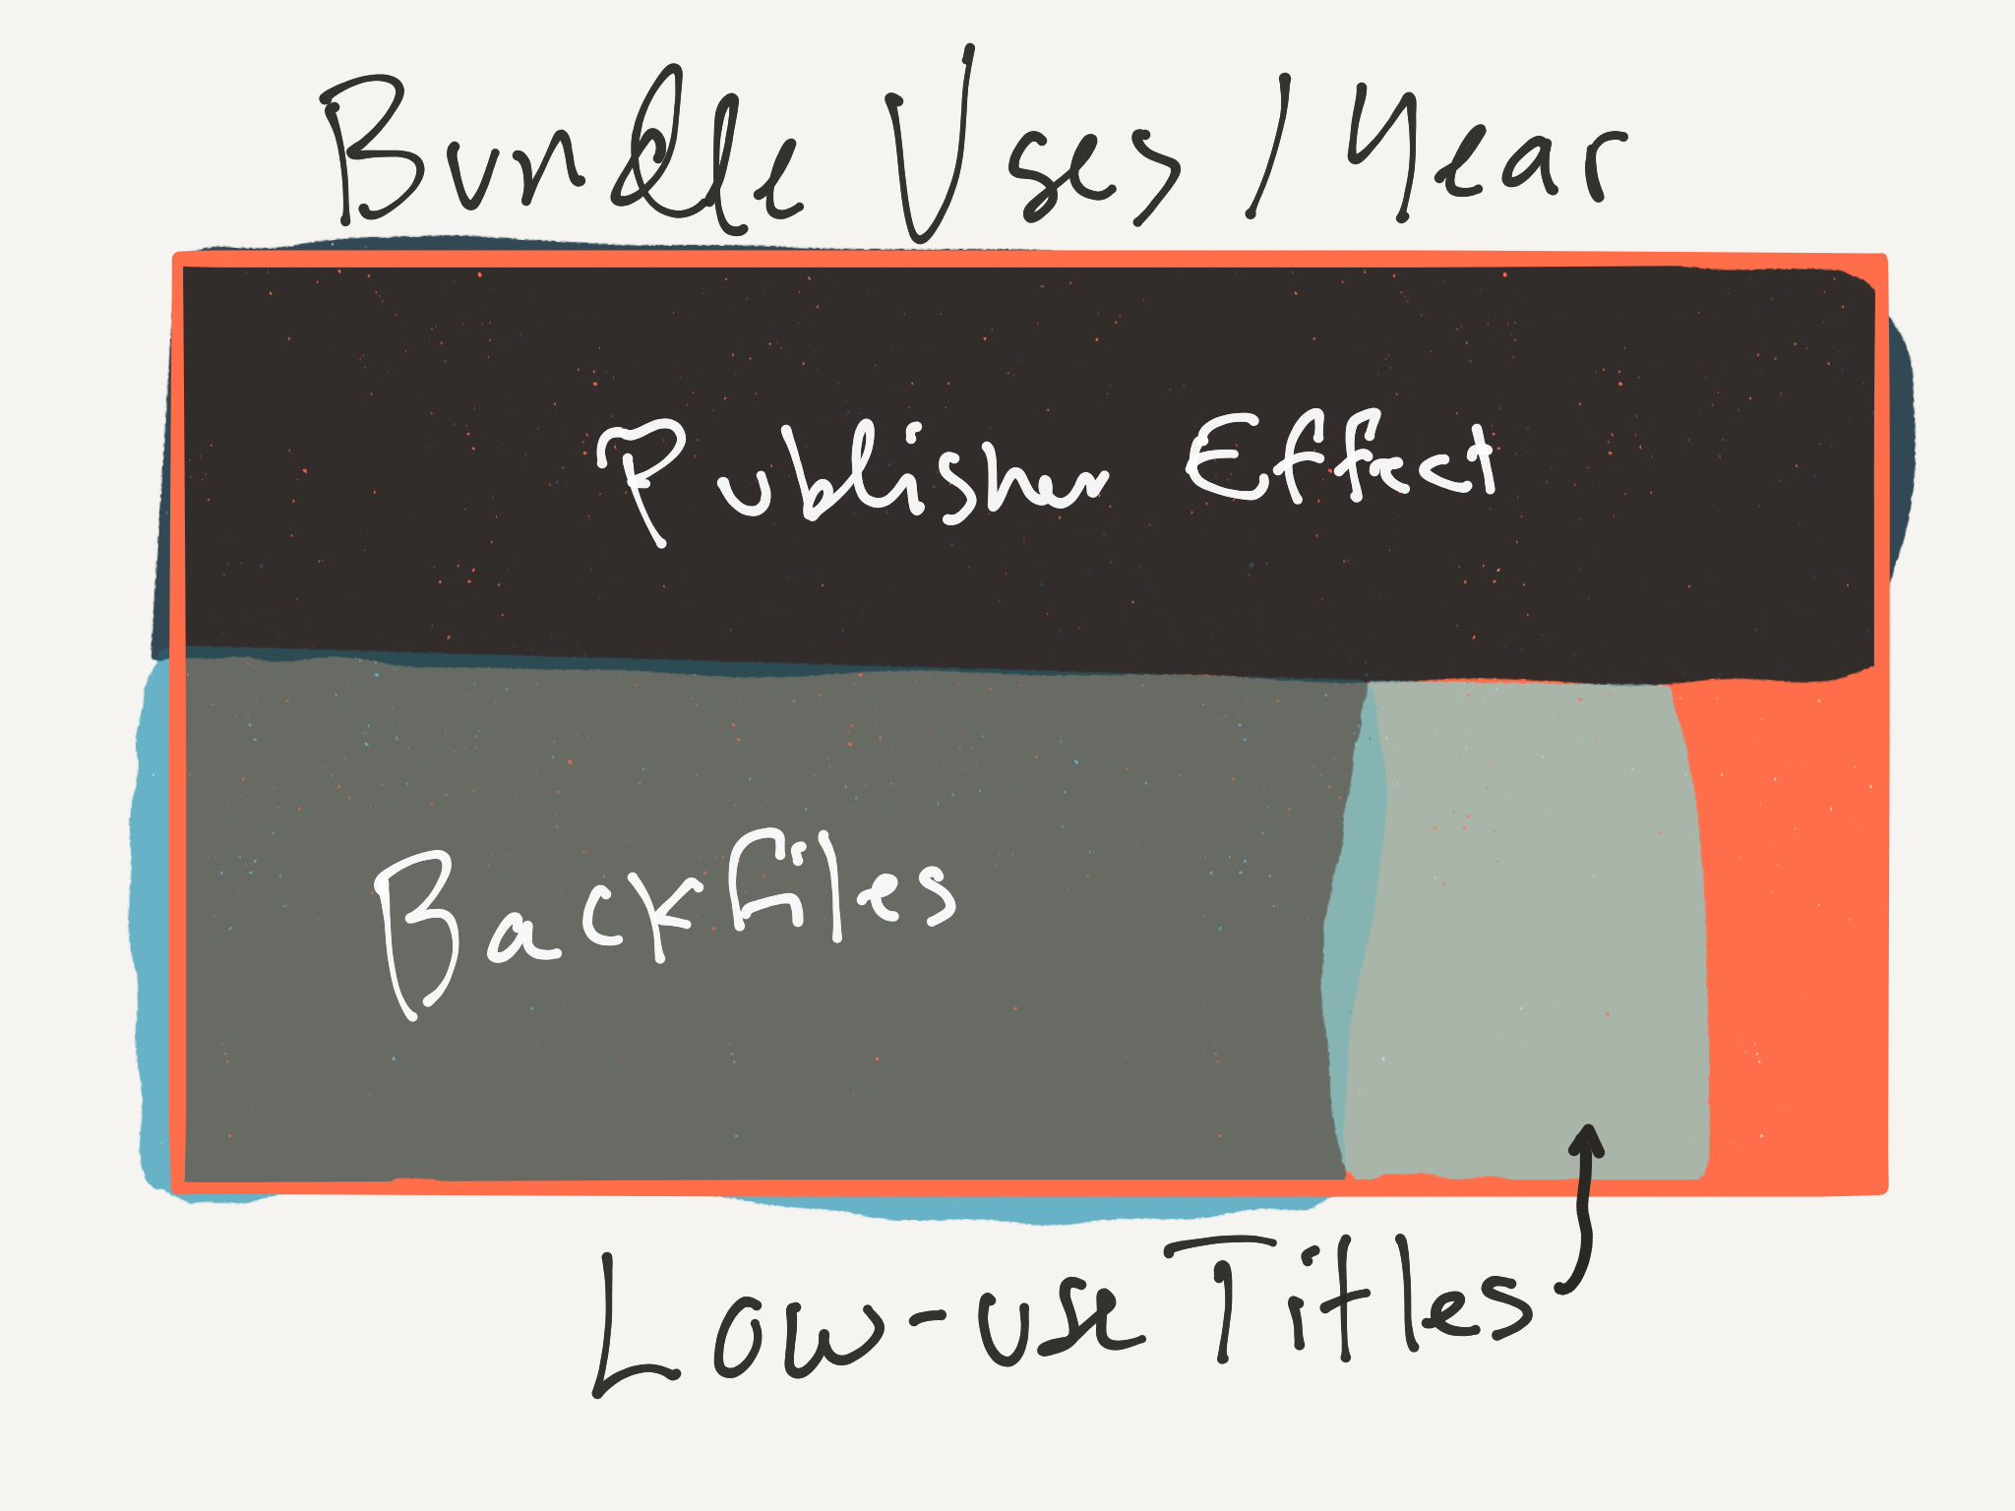

Slide 25
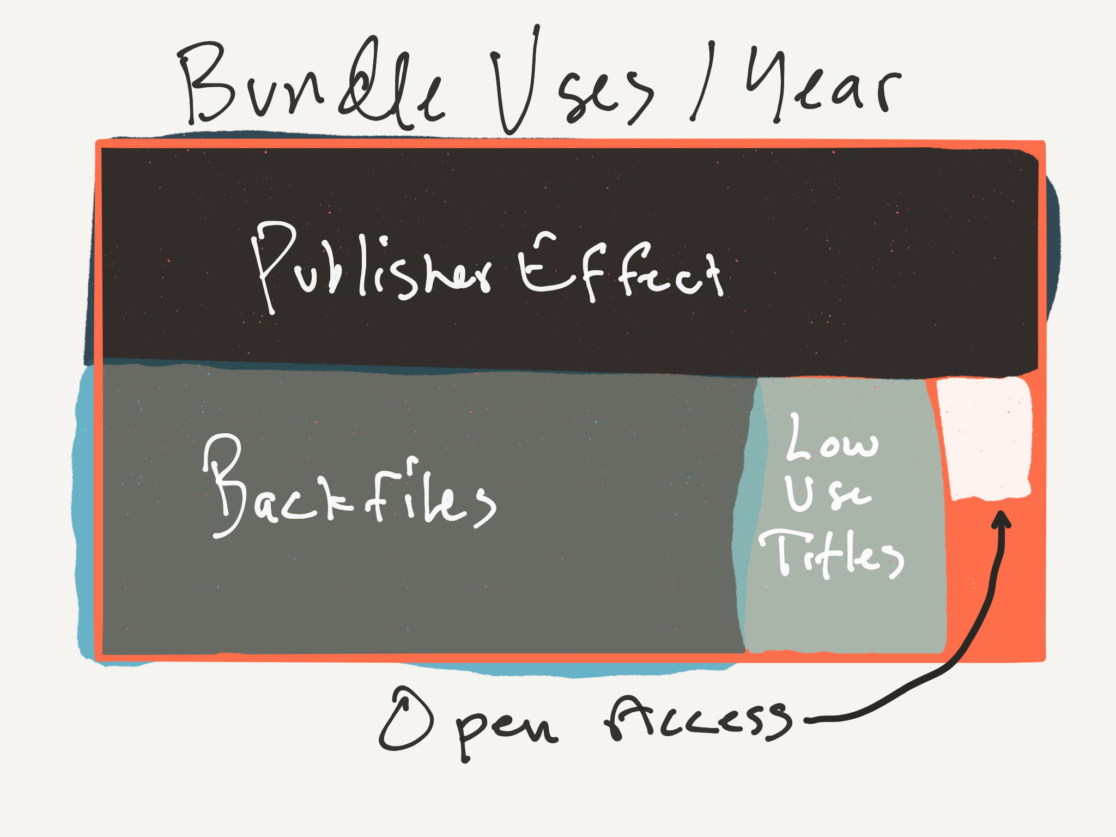

Slide 26
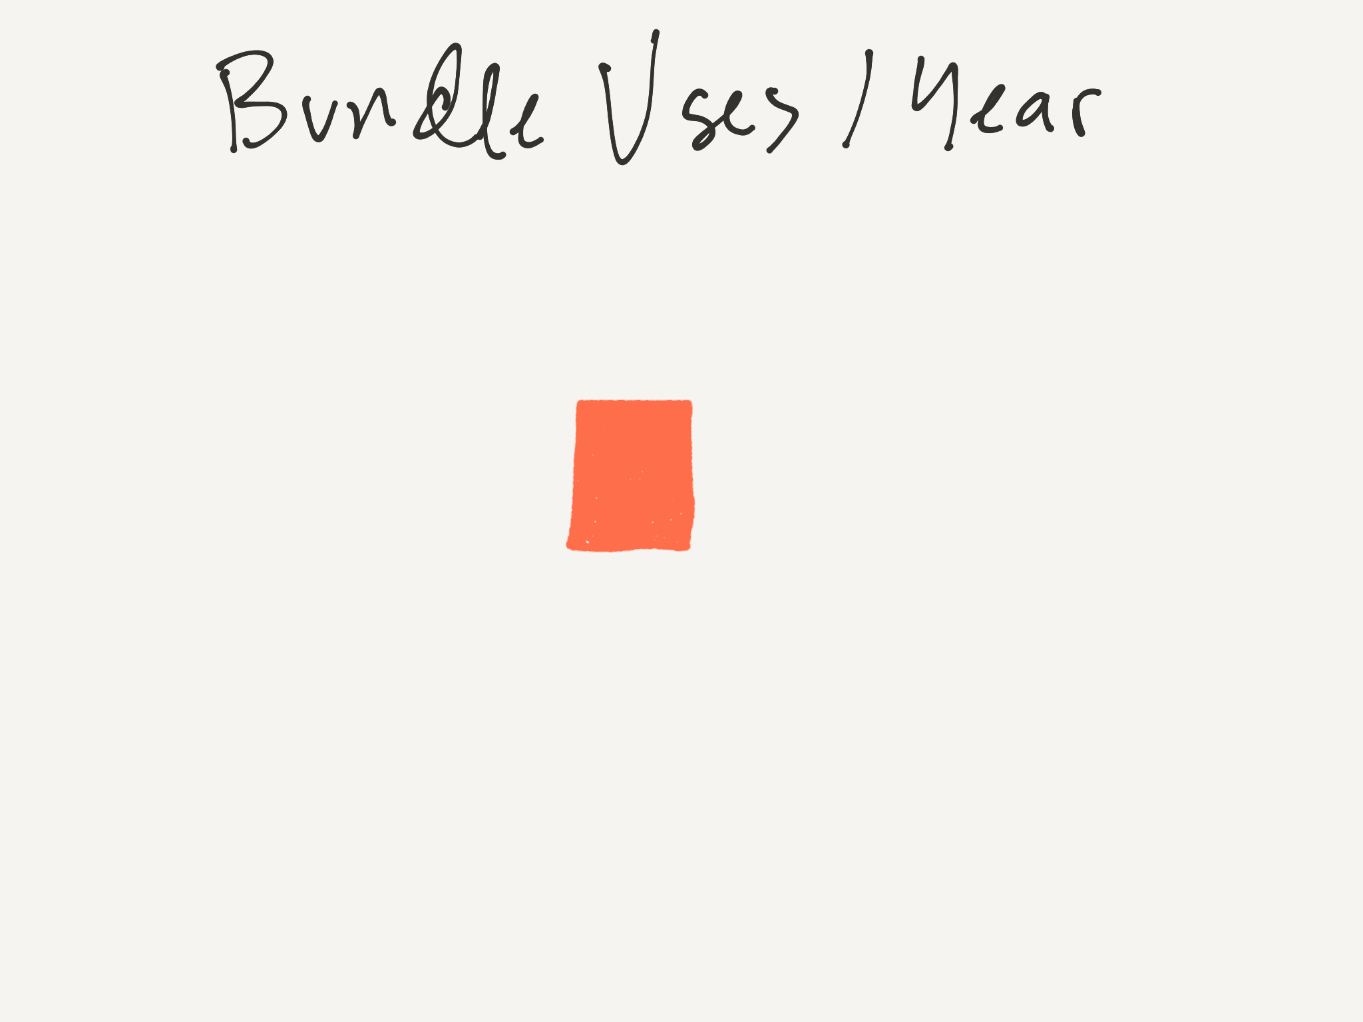
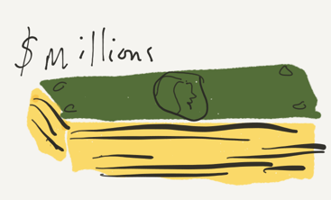

Slide 27
Other problems with “Cost per use”
Site design influences “use”
Deep catalogs have an advantage
Usage practices vary by field
Diverse content types in some (v. prestigious) journals
Usage spikes (e.g. from course use) can hide in annual data
Portfolios can be volatile as titles move around
Aggregators like Ebsco, ProQuest, Hein, Gale offer alternatives
Year-to-year fluctuations in quality - blockbuster issues vs. duds
Untethered to publishers’ value-add, or their cost (marginal=0!)

Slide 28
OA on the Rise
Plan S
OA 2020
Funder Initiatives (ORFG)
Federal and state policies
Nat’l Academies roundtable — "aligning incentives for open science"
Preprints on the rise (Biorxiv report, e.g.)
Open data, open science decentering the article

Slide 29
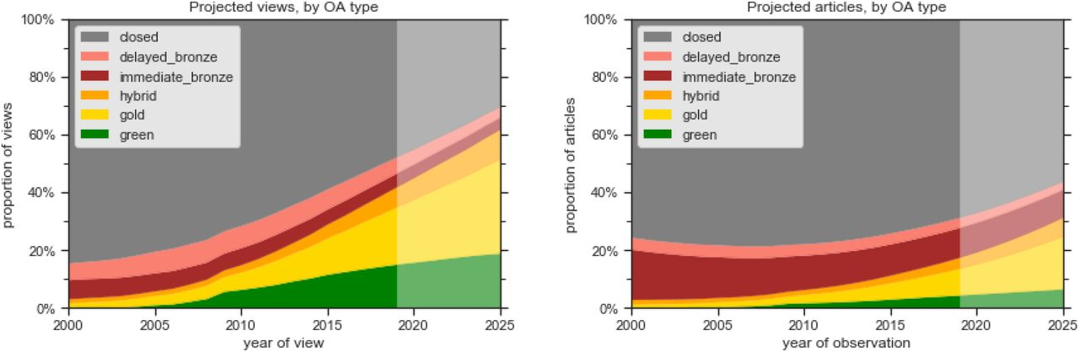
The Future of OA: A large-scale analysis projecting Open Access publication and readership
Heather Piwowar, Jason Priem, Richard Orr
bioRxiv 795310; doi: https://doi.org/10.1101/795310

Slide 30
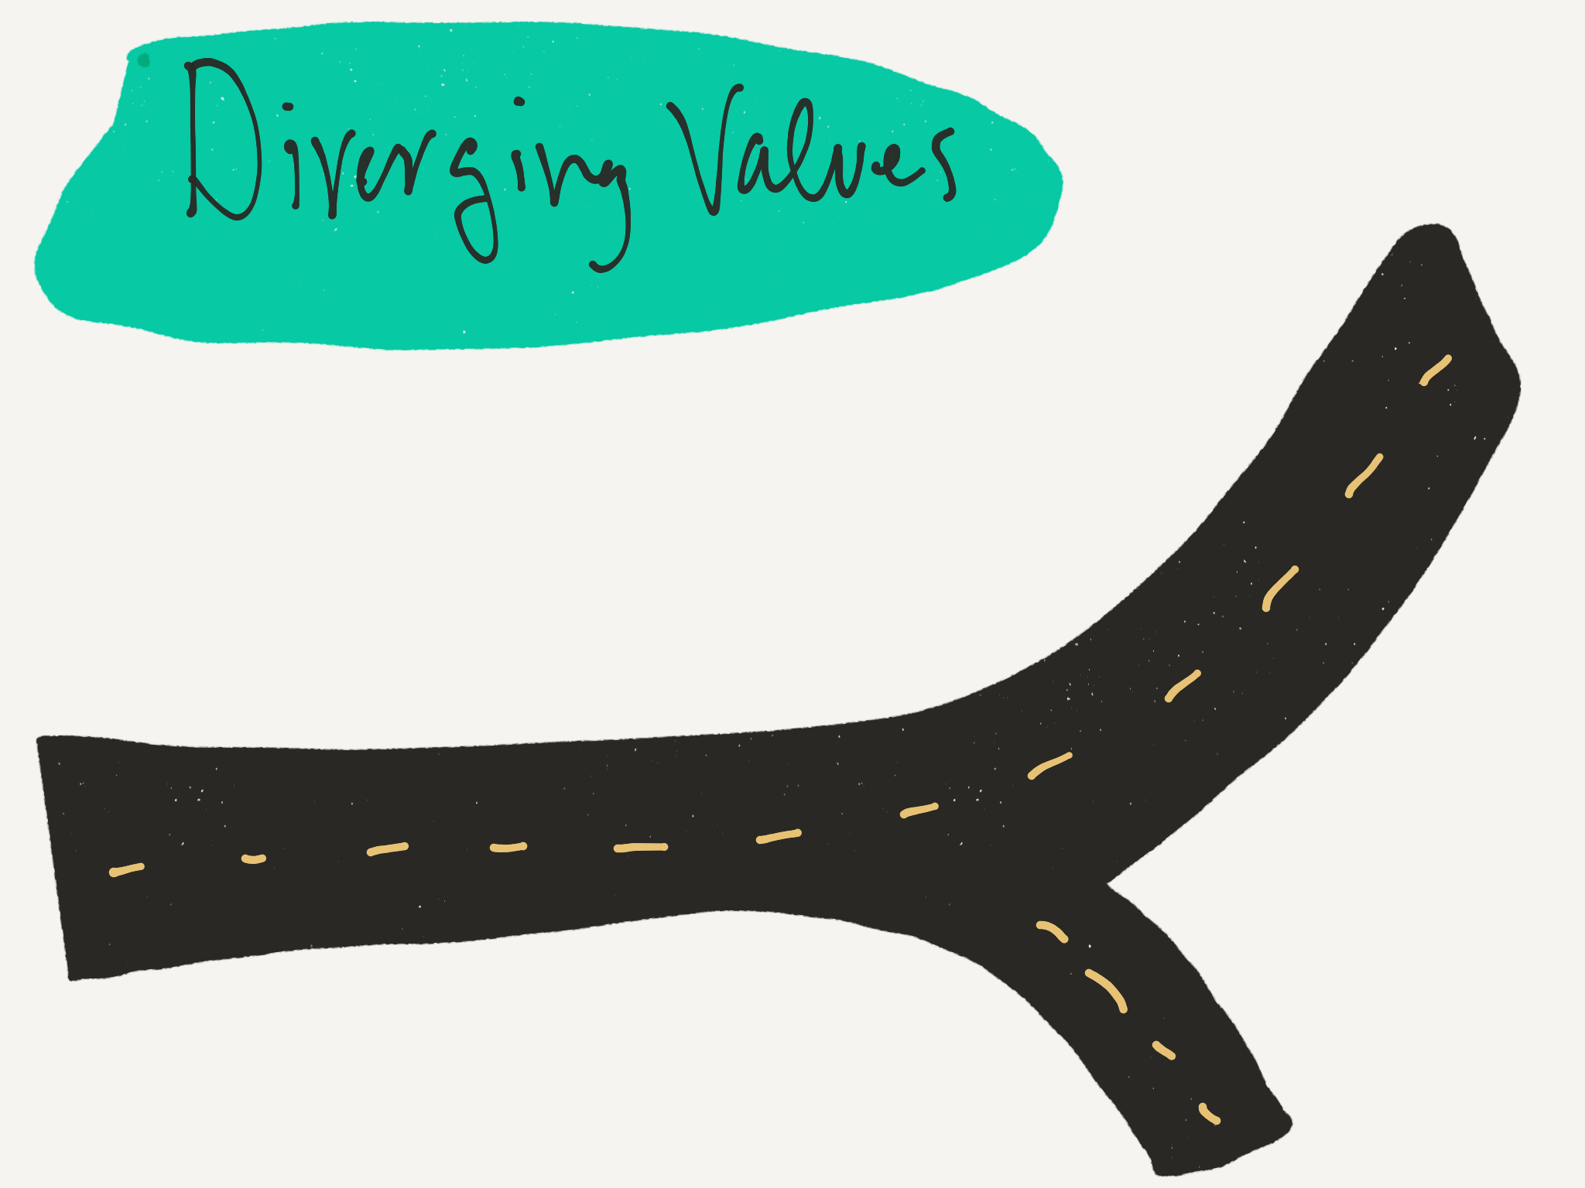

Slide 31
“An old tradition and a new technology have converged to make possible an unprecedented public good. The old tradition is the willingness of scientists and scholars to publish the fruits of their research in scholarly journals without payment, for the sake of inquiry and knowledge. The new technology is the internet. The public good they make possible is the world-wide electronic distribution of the peer-reviewed journal literature and completely free and unrestricted access to it by all scientists, scholars, teachers, students, and other curious minds.”
–Declaration of the Budapest Open Access Initiative, 2/14/02

Slide 32
“Springer Nature was one of the first academic publishers to actively embrace the opportunities offered by open access, which provides us additional opportunities to generate revenues, as open access publications are funded by authors and/or their funders or the relevant research institutions, not libraries. Accordingly, revenues stemming from APCs are in the short- to medium-term supplementary to the subscription business, not cannibalistic. Some of our journals are among the open access journals with the highest impact factor, providing us with the ability to charge higher APCs for these journals than for journals with average impact factors.”
–SpringerNature, in its Prospectus for a (failed) IPO

Slide 33
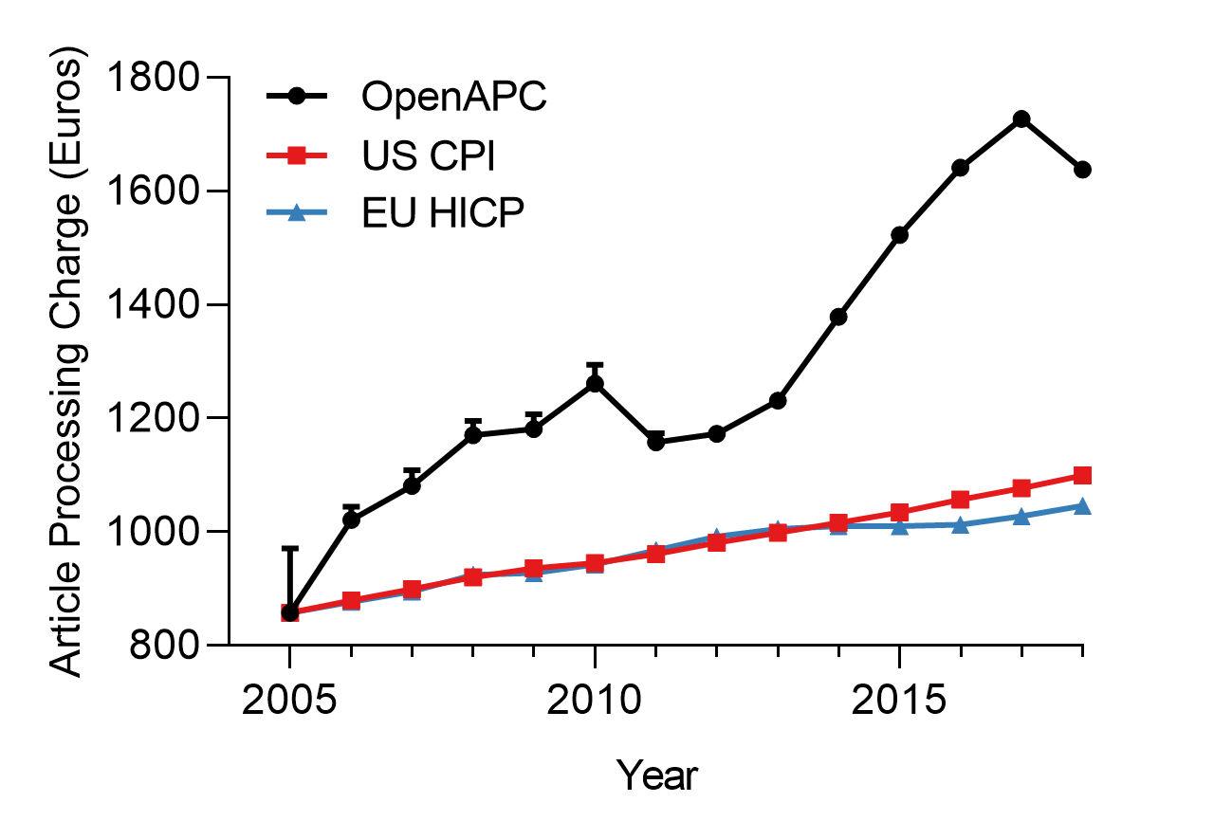

Slide 34
Life After Big Deals
Instant access via:
subscriptions to essential titles
open access (via integrated search tools)
document delivery
Delayed access via
interlibrary loan
author requests
“Soft turnaways”

Slide 35
Recap
Big Deals are journal bundles sold by the biggest journal vendors
A global consensus favors Big Deal reform
Big Deals are expensive, and they’re taking over our budgets
Their value is in decline, and alternative access has never been easier
The values of the biggest vendors are misaligned with the academy
Life goes on after Big Deals

Slide 36
Further Reading
Buranyi, Is the staggeringly profitable business of scientific publishing bad for science?, The Guardian, https://www.theguardian.com/science/2017/jun/27/profitable-business-scientific-publishing-bad-for-science
Negotiating with scholarly journal publishers: A toolkit from the University of California, https://osc.universityofcalifornia.edu/open-access-at-uc/publisher-negotiations/negotiating-with-scholarly-journal-publishers-a-toolkit/
Larivière V, Haustein S, Mongeon P (2015) The Oligopoly of Academic Publishers in the Digital Era. PLOS ONE 10(6): e0127502. https://doi.org/10.1371/journal.pone.0127502
SPARC, Big Deal Cancellation Tracking, https://sparcopen.org/our-work/big-deal-cancellation-tracking/
Butler, Six Things UVA Researchers Need to Know About the UC System Walking Away from Elsevier, https://news.library.virginia.edu/2019/03/07/six-things-uva-researchers-need-to-know-about-the-uc-system-walking-away-from-elsevier/
Potter, University research produced for public good must be available to those who pay for it, Richmond Times Dispatch, https://www.richmond.com/opinion/their-opinion/peter-potter-column-university-research-produced-for-public-good-must/article_d5cfc530-a972-5df0-a24c-91ee7b4ca2d8.html.
Serven-Smith, UVa eyes new way to purchase scholarly journals, Daily Progress, https://www.dailyprogress.com/news/uva/uva-eyes-new-way-to-purchase-scholarly-journals/article_50b692b2-7517-11e9-8499-1f86f89a0d11.html
Shaun Yon-Seng Khoo, Article Processing Charge Hyperinflation and Price Insensitivity: An Open Access Sequel to the Serials Crisis, 29 LIBER Quarterly 1 (2019), https://www.liberquarterly.eu/article/10.18352/lq.10280/ (last visited Oct 7, 2019).
Statement from Deans and Directors of Virginia Research Libraries on the University of California System’s Termination of Contract with Elsevier, https://news.library.virginia.edu/2019/04/09/statement-from-deans-and-directors-of-virginia-research-libraries-on-the-university-of-california-systems-termination-of-contract-with-elsevier/.

Slide 37
Further Reading (cont’d)
Heather Piwowar et al., The state of OA: a large-scale analysis of the prevalence and impact of Open Access articles, 6 PeerJ e4375 (2018), https://peerj.com/articles/4375 (last visited May 29, 2019).
Theodore C Bergstrom et al., Evaluating big deal journal bundles., 111 Proceedings of the National Academy of Sciences of the United States of America 9425–30 (2014), http://www.pnas.org/content/111/26/9425.abstract.
Jonathan Nabe, After the Big Deals Are Done, Against the Grain (2017), https://against-the-grain.com/2017/04/v29-1-after-the-big-deals-are-done/.
University of Montreal, Report of the Working Group on Periodical Collections, http://www.bib.umontreal.ca/a-propos/rapport-gtcp-vf_14-10-2015.pdf (last visited Jul 3, 2018).
Kathleen Shearer, Responding to Unsustainable Journal Costs (2018), http://www.carl-abrc.ca/wp-content/uploads/2018/02/CARL_Brief_Subscription_Costs_en.pdf.
Roger C. Schonfeld, Is the Value of the Big Deal in Decline? The Scholarly Kitchen (2019), https://scholarlykitchen.sspnet.org/2019/03/07/value-big-deal-leakage/ (last visited Jul 1, 2019).
Breaking Bad, Good or Mixed? Perspectives on exiting (and sometimes re-entering) journal package deals, ASERL Webinar Recording (2016), https://vimeo.com/188899571.
Kristin Antelman, Leveraging the Growth of Open Access in Library Collection Decision Making 12 (2017), http://www.ala.org/acrl/sites/ala.org.acrl/files/content/conferences/confsandpreconfs/2017/LeveragingtheGrowthofOpenAccess.pdf.
Ted Bergstrom, Richard Uhrig & Kristin Antelman, Looking under the COUNTER for overcounted downloads (2018), https://escholarship.org/uc/item/0vf2k2p0 (last visited Mar 6, 2019).
Heather Piwowar, Jason Priem, Richard Orr, The Future of OA: A large-scale analysis projecting Open Access publication and readership, bioRxiv 795310; doi: https://doi.org/10.1101/795310 (last visited Oct. 18, 2019).

